Slide 1
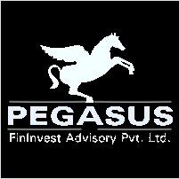
Investment Philosophy
Pre-Series A & Series A focused on FinTech, Healthcare, Education & CleanTech
We propose to invest in asset light India focused startups with significant potential for progressive socio-economic impact. The investments will be made post proof of concept to spur growth.
Investment Metrics:
Strong Team | Large Addressable Market size
Product-Market Fit | Strong unit economics
Exit Opportunities | Cash flow sustainability
Clear Path to Scale
Social impact: We measure and monitor our startups’ contribution to their stated impact objectives and associated Sustainable Development Goals (SDGs). We ensure the investee company demonstrates efforts towards a sustainable and inclusive future using an Environmental and Social Management System (ESMS).
Creating an alpha as Operational Investors: We mentor our startups and assist with business strategy, market analyses, cost optimization, business model revision and operational processes. We instill a mindset ,which aims to create an operationally sustainable, cash flow business.
Outcome: While we strive to maximize the financial returns on our investments, we also wish to create a positive socio-economic impact on the ecosystem built around our portfolio companies

Slide 2


The PEGASUS Mission
As Operating Investors, we wish to move beyond capital infusion, and create an ecosystem, which helps our companies succeed in building Sustainable Operating Cash Flow Models, and thrives on entrepreneurial passion.
While we are focused on generating financial gains, we wish to leave a larger footprint around the ecosystem we develop. Our companies will be focused on generating a positive socio-economic impact, while operating as ‘Responsible Businesses’.

Slide 3
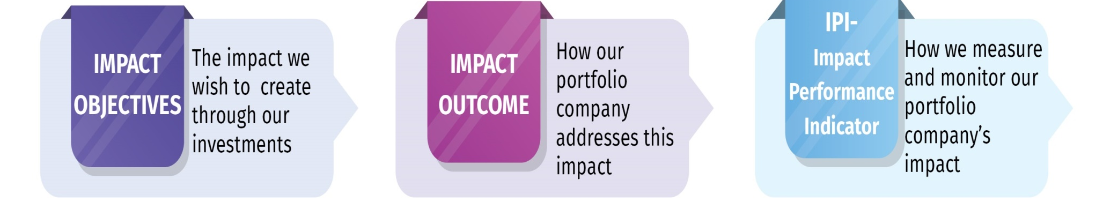
Why Operations Focused
With a growing churn rate, entrepreneurs still face substantial challenges in moving past the series A stage of their lifecycle
High Cash Burn to Revenue
Lack of Operational Efficiency
Lack of Clear Strategy
Lack of Mentorship
Talent Management
Product Market Fit, Generating cash flows & operational prudence are essential to the survival of a startup, which presents an opportunity for operational investors to guide its portfolio companies and increase the success ratio of early stage companies
PEGASUS FACTOR
The Impact Factors
We are firm believers in Impact + Profits. What is not measured and monitored cannot be managed. And thus we use an impact assessment and monitoring framework to ensure our entrepreneurs can manage the larger footprint they leave on society.

Slide 4
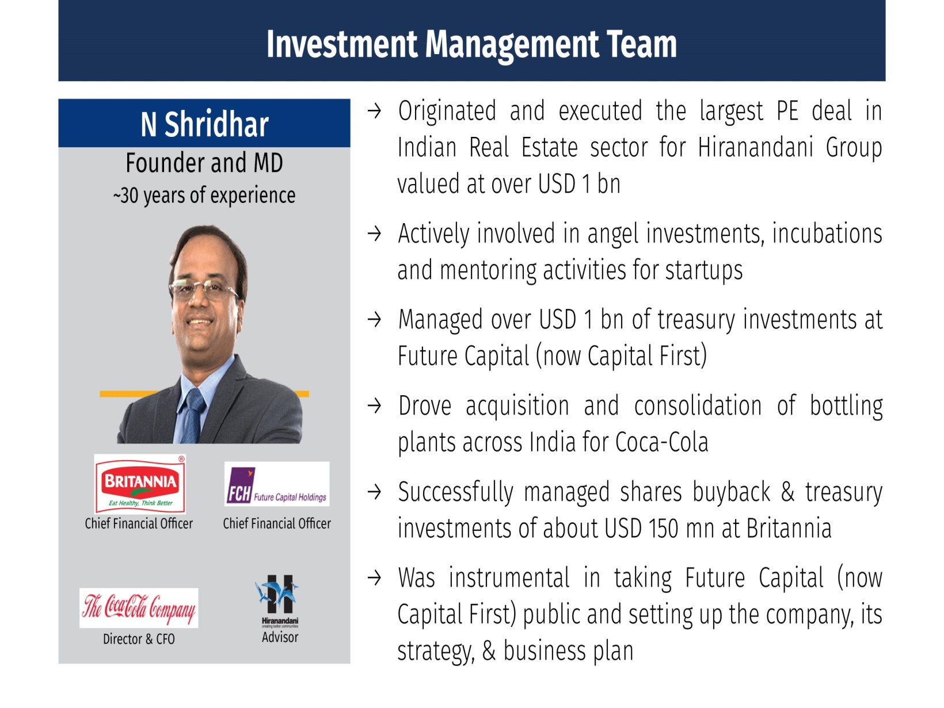
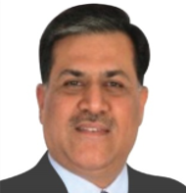
The Pegasus Team
Shridhar N
Prakash Ranjalkar
Founder & Managing Director
Operating Partner
As CIO of Hiranandani Group, executed the largest PE deal in the Indian Real Estate Sector valued at over USD 1 billion
Managed over USD 1 billion of treasury investments as CFO of Future Capital. Investment Committee & Board Member of Everstone Capital , a USD 1 billion AIF
As Director & CFO of Coca Cola India Bottlers , took Balance Sheet from 0 to USD 1 billion through M&A and investments
Leadership roles across operations , investing and strategy across various industries.
As Ex – CEO for Africa Towers NV (Bharti Airtel, Africa), led third party revenue enhancement up to USD 100 million annually . Part of core team in monetizing tower assets amounting to a deal of up to USD 2 billion
Ex CEO, COO of a large public listed telecom tower company. Took from concept to growth and grew it to USD 200 million revenues.
Managed & operated CapEx investments of USD 500 million
Led M&A deals in the telecom, enterprise network sector with deal sizes in excess of USD 1 billion.
Notes:
4

Slide 5
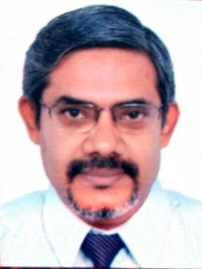
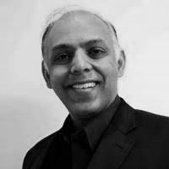
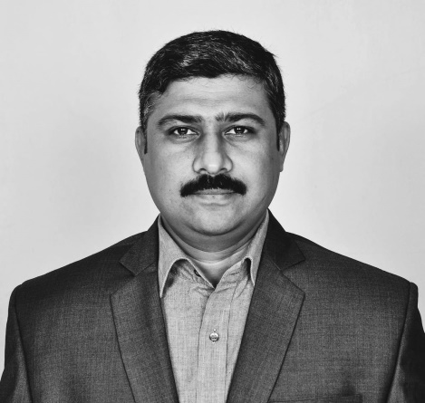
The Pegasus Team
Subhash Lode
Vasant Kumar
Bala Palamadai
(Sr Manager Investment and Operations)
(Head of Investment & Operations Renewable Energy Sector)
Partner & Technology Advisor
16+ years of experience in AgriTech, InfoTech, Data Science, AI, ML and Enterprise Blockchain.
He has worked as advisor for Mission Samriddhi, on Agriculture & Livelihood - CSR Initiative of Intellect Design Arena (Erstwhile Polaris Software).
He has worked with Harsco, Unisys, Hexaware to lead Aftermarket and Master Data Management ERP Implementations in USA, UK, and the Netherlands
28 years of operational experience
23 years with Asian Paints across locations in India
Held senior management positions in Operations, Projects & Plant Engineering
Evaluation & execution of renewable energy projects (solar & wind energy )
Evaluation & adoption of new technology
More than 18 years of experience in in the IT Services & Consulting industry
Former Executive Vice President at Microland, tasked with accelerating growth in the US & European geographies.
Leadership roles at various leading IT Companies including Infosys
President of TiE Midwest
Founder of Bizofit, a Chicago based accelerator
Notes:
5

Slide 6
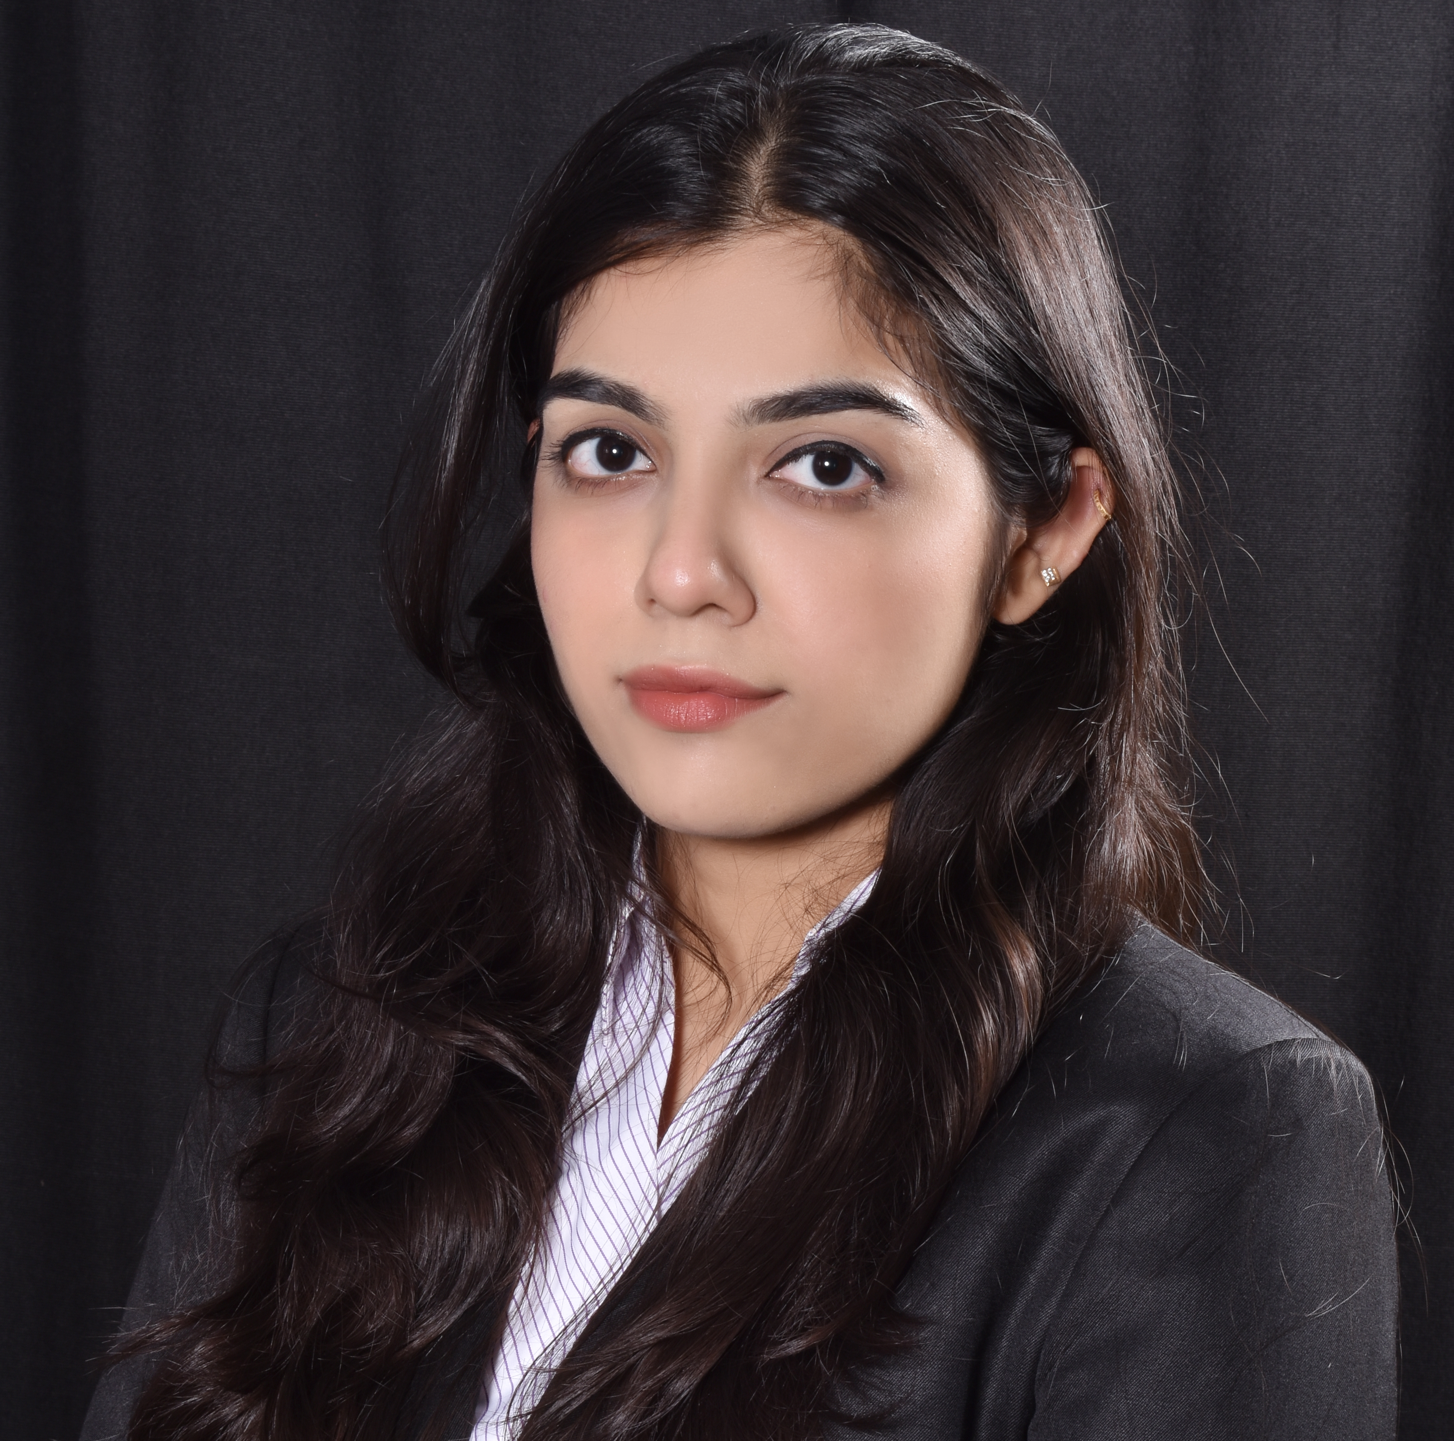
The Pegasus Team
Rumsha Kapadia
Management Trainee
Bachelors in Management Studies with a specialization in Finance from Mumbai university.
Graduated with a CGPA of 9.86. Has cleared CFA level 1 in February 2021. Well versed with all subjects of finance.
Experienced with financial statements, valuation models and statistics.

Slide 7

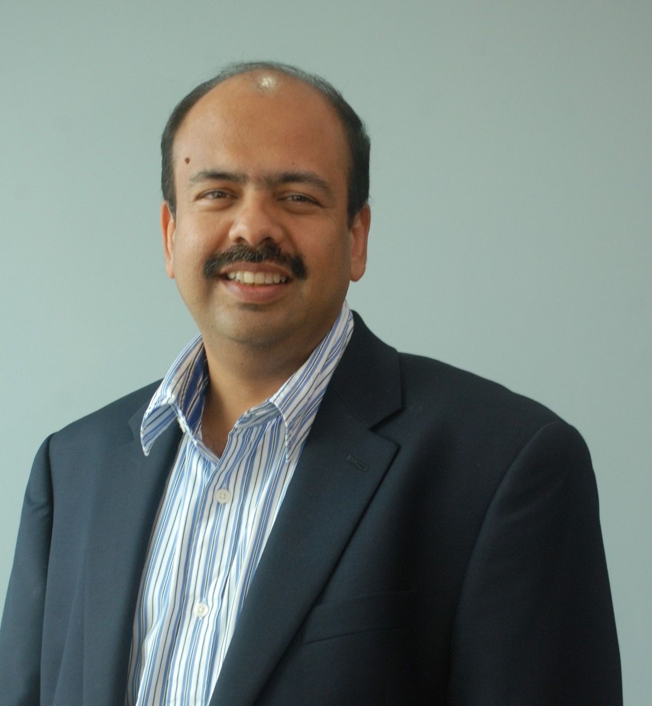
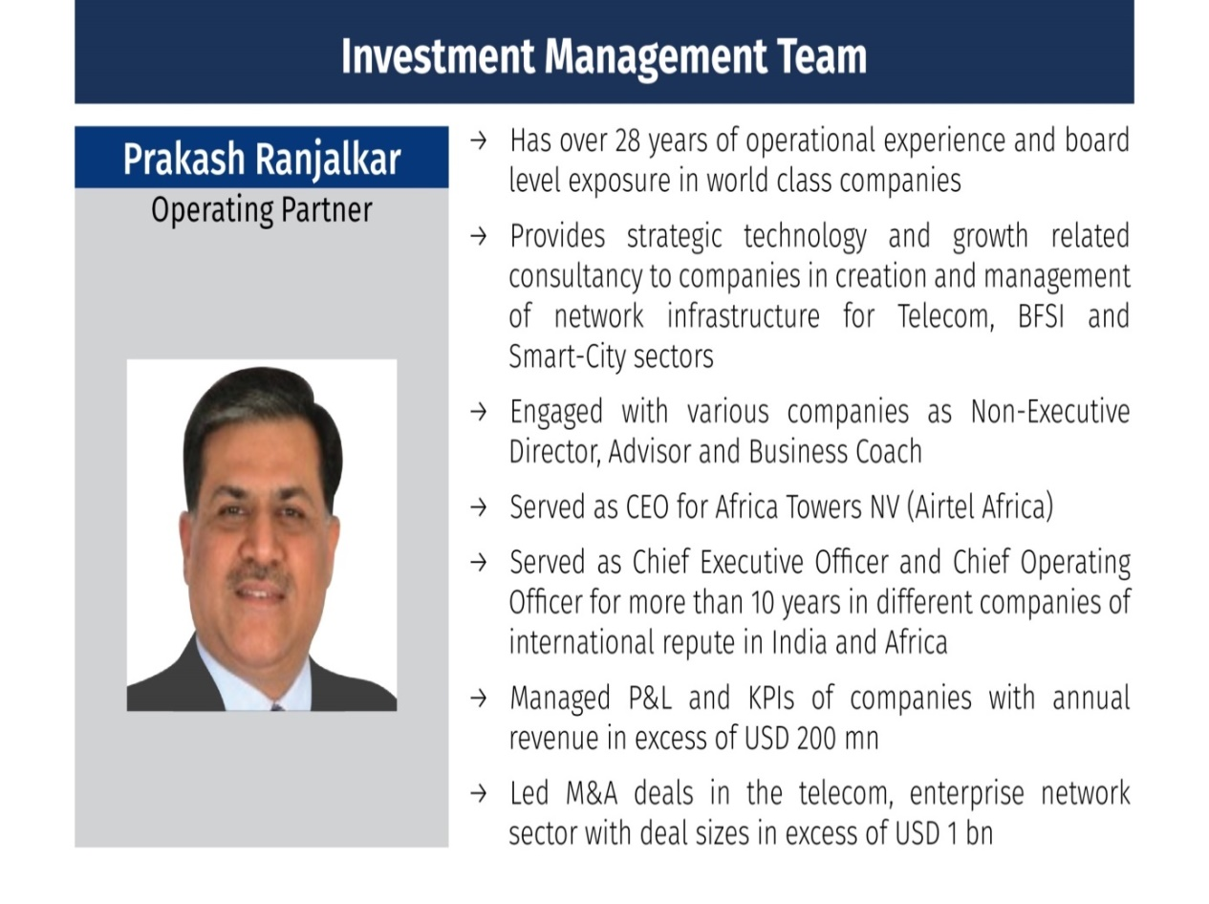
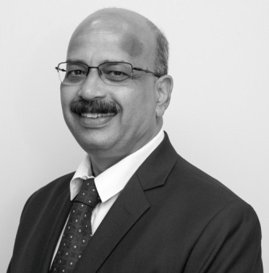
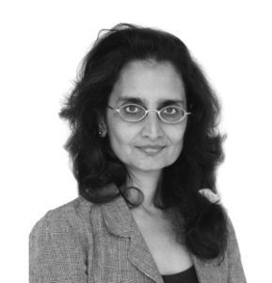
The Investment Committee
Narayan Shridhar
Sharad Sanghi
Prakash Ranjalkar
Impact, Governance, Risk & Compliance Committee
IGRC – An external committee, which oversees the actions of the Investment Committee and is responsible for the following:
ESG Compliance and Sanity Checks for portfolio companies
Impact parameter approval and monitoring of our portfolio companies
Suhas Tuljapurkar Managing Partner
Legasis Partners
Jaya Singhania Partner
Cyril Amarchand Mangaldas

Slide 8
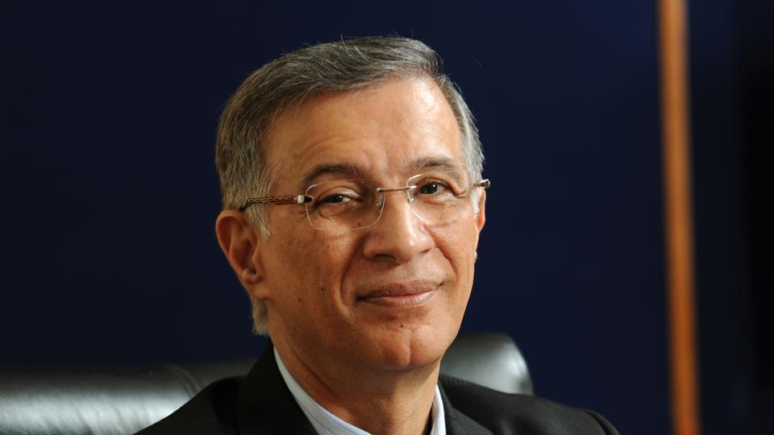
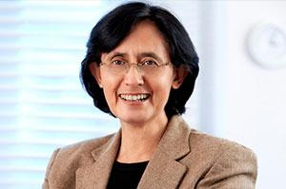
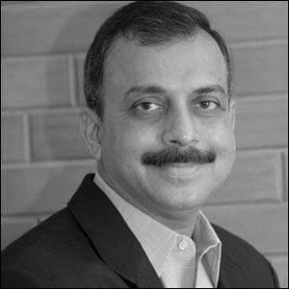
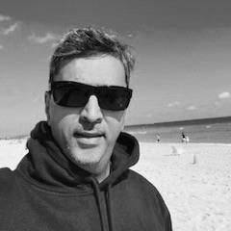
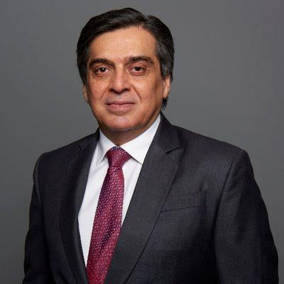
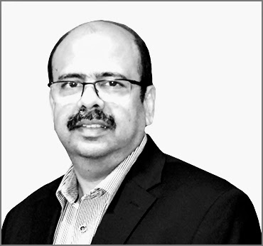
Advisors & Mentors
Niranjan Hiranandani Chairman
Hiranandani Group
Vinita Bali Ex - CEO
Britannia Industries
Shripad Nadkarni Director
MarketGate Consulting
G Devanathan Ex - Partner
Goldcrest Advisors
Shishir Baijal Chairman
Knight Frank
Sharad Sanghi
MD & CEO at NTT-Netmagic

